Slide 1
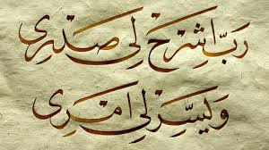
Aaouzu billahi min as ash-shaytaan nir rajeem
BISMILLAH HIR RAHMAAN NIR RAHEEM

Slide 2
HAJJ PRESENTATION
Surah Al-Baqarah
(verse 197-207)
LABBAIK ALLAHUMMA LABBAIK

Slide 3
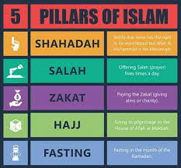

Slide 4
الحج اشهر معلومات فمن فرض فيهن الحج فلا رفث ولا فسوق ولا جدال في الحج وما تفعلوا من خير يعلمه الله وتزودوا فان خير الزاد التقوى واتقون يا اولي الالباب
(197)
ليس عليكم جناح ان تبتغوا فضلا من ربكم فاذا افضتم من عرفات فاذكروا الله عند المشعر الحرام واذكروه كما هداكم وان كنتم من قبله لمن الضالين
(198)

Slide 5
Ayah 197 الحج اشهر معلومات
Hajj is [during] well-known months
These are:
Shawwal
Dhul-Qa`dah and
The first ten days of Dhul-Hijjah

Slide 6
The DOs and DONTs in HAJJ

Slide 7
whoever has made Hajj obligatory upon himself therein [by entering the state of ihram]

Slide 8

فلا رفث (no sexual relations)
Note: Remember only Allah (s.w.t)

Slide 9


ولا فسوق(no disobedience)
Note: Learn Tolerance

Slide 10
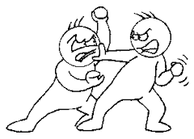

ولا جدال(no disputing)

Slide 11
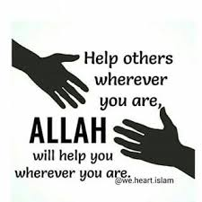
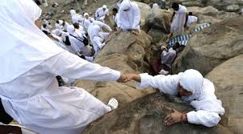
And whatever good you do - Allah knows it.
HAJJ teaches UNITY
It is a training period (once in a life) for the entire life.
We should Always help a Momin Whenever he struggles in this world and show them the right Path.

Slide 12

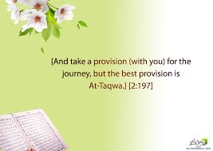
TAQWA
(P.S. It does’nt require any extra luggage just keep it in YOUR HEART)

Slide 13
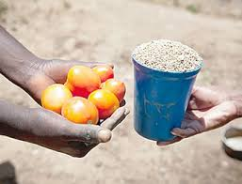
Ayah 198 تبتغوا فضلا من ربكم seek bounty from your Lord [during Hajj].
It is no sin if a man sets out to seek God's good pleasure and during the same journey tries to combine that purpose with the quest for permissible worldly benefits (trade).
There is no sin on you if you buy and sell before and after ihram.

Slide 14
……………..But when you depart from 'Arafat, remember Allah at al- Mash'ar al-Haram. And remember Him, as He has guided you, for indeed, you were before that among those astray.(198)
Biddat: during the Age of Ignorance , polytheistic and pagan practices were followed by Arabs and which ran alongside the worship of God.
thereby in these ayahs it is ordered to them to give up those practices. And worship Allah s.w.t alone according to the guidance He had now revealed through the Prophet (p.b.u.h)

Slide 15
ثم افيضوا من حيث افاض الناس واستغفروا الله ان الله غفور رحيم Then depart from the place from where [all] the people depart and ask forgiveness of Allah . Indeed, Allah is Forgiving and Merciful.(199)
MIQAT
KA’BA
MINA
ARAFAT
MASH’AR AL-HARAM
Hajj
Umrah
HAJJ E TAMATTAW

Slide 16
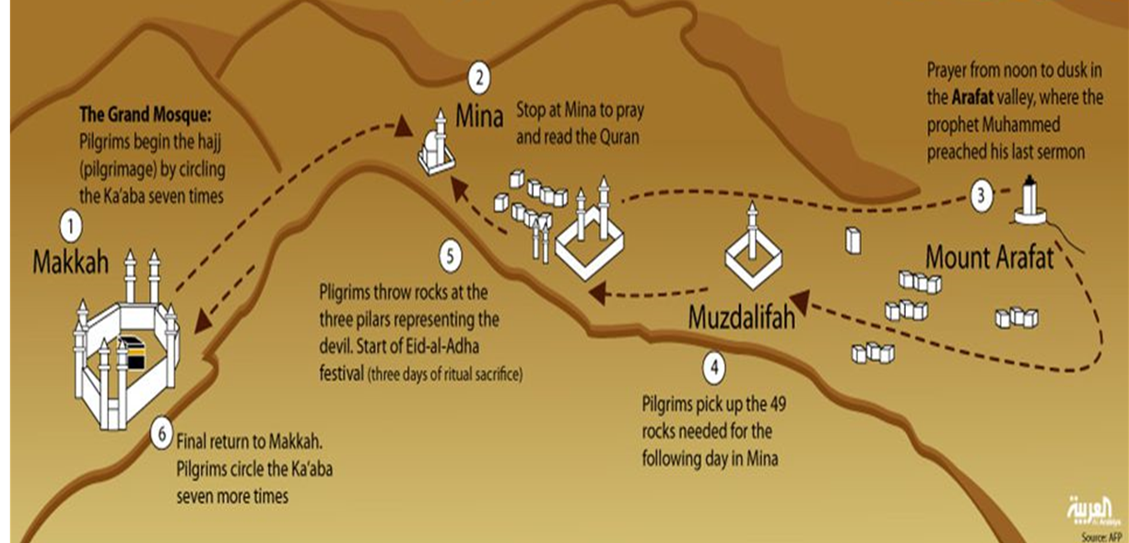

Slide 17
Ayat:199
Quraysh claimed that it was below their dignity to go to 'Arafat with the ordinary people of Arabia. As a mark of what they called their distinction, they went to Muzdalifah only (without going to 'Arafat) and returned from there, leaving it to the commoners to go to 'Arafat.
Such people are asked to go to the place to which all others go, to stay with them, to return with them and to seek pardon from God for the fact that they violated the way of Abraham (a.s.)

Slide 18
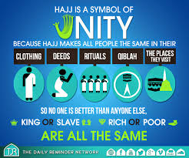
HAJJ TEACHES UNITY

Slide 19
فاذا قضيتم مناسككم فاذكروا الله كذكركم اباءكم او اشد ذكرا فمن الناس (200)من يقول ربنا اتنا في الدنيا وما له في الاخرة من خلاق
ومنهم من يقول ربنا اتنا في الدنيا حسنة وفي الاخرة حسنة وقنا عذاب (201)النار
(202)اولئك لهم نصيب مما كسبوا والله سريع الحساب

Slide 20
Ayah: 200
After Completing the Hajj the Arabs used to hold rallies at Mina and narrated the achievements of their forefathers and self-praise. Here they are asked to remember Allah (s.w.t) like their forefathers or even more.
Do Dhikr = remembrance of ALLAH (S.W.T) at Mina.
Importance of Dhikr+Dua

Slide 21
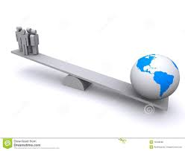

Ayah 200-201 See your Reflection in your DUA
Among people are those who ask only for this duniya (worldly things)
Among them are those who ask the Duniya and Aakhirat (Hereafter) and protection from hellfire.
(our DUA should be Balanced!!!!)

Slide 22
واذكروا الله في ايام معدودات فمن تعجل في يومين فلا اثم عليه ومن تاخر فلا اثم عليه لمن اتقى واتقوا الله واعلموا انكم اليه
(203)تحشرون
DO Dhikr (remembrance of Allah s.w.t) during these appointed days.
ايام معدودات The days of Tashreeq (mina) are the 11th, 12th and 13th of Dhu’l-Hijjah.
If there is a need then there is no sin upon him who want to depart after 2 days.
those who delay (i.e., remain in Mina for a third day) then there is no sin in it.
But FEAR ALLAH

Slide 23
ومن الناس من يعجبك قوله في الحياة الدنيا ويشهد الله على ما (204)في قلبه وهو الد الخصام
واذا تولى سعى في الارض ليفسد فيها ويهلك الحرث والنسل (205)والله لا يحب الفساد
واذا قيل له اتق الله اخذته العزة بالاثم فحسبه جهنم ولبئس
(206)المهاد
ومن الناس من يشري نفسه ابتغاء مرضات الله والله رءوف (207)بالعباد

Slide 24
Ayah 204-207 Two types of people are described in these ayahs
Munafiq
ALLAH (s.w.t)’s Momin
pleases people only through sweet talk.
Make false promise over Allah (s.w.t) to prove himself.
They are most fiercest of opponents of Muslims and bring most harm.
but through actions brings fasad/corruption on land.
destroy crops and animals.
They do not have taqwa are are driven in pride.
End of such people will be in Hell fire.
Person who sells himself for Allah (s.w.t)
مرضات الله Seeks Allah (s.w.t) RAZA.
Always ready for a good deed.
Does not follow his Nafs.
Have sabr at all times.
Allah (s.w.t) is kind to his servants.

Slide 25
Points to Remember
Hajj resembles our Departure from this Duniya.
The changes in Life after Hajj are the signs of an Accepted Hajj.
Your increased will for good deeds.
Learn Tolerance
All are Equal before Allah (s.w.t)
Do not wait for an age to perform Hajj if you are capable.
Remember Allah (s.w.t) at All times.
Have Taqwa at all times in life.
Our DUA should be balanced (DUNIYA+AAKHIRAH)
Seek Allah (s.w.t) Approval in every Nemat.

Slide 26
رَبَّنَا تَقَبَّلْ مِنَّا إِنَّكَ أَنْتَ السَّمِيعُ العَلِيمُ
AAMEEN……….

